Slide 1


Sales Insights Dashboard – Power BI Project
A Real-world Data Analytics Case Study by Ekta Bhowad.
This project demonstrates building a comprehensive sales insights dashboard using Power BI, simulating a real business scenario.
by EKTA BHOWAD

Slide 2









Table of Contents
Problem Statement
Identifying the core sales tracking challenges.
Objective
Defining clear goals for the data analysis.
Data Discovery
Exploring the available datasets and their structure.
SQL Analysis
Extracting initial insights using SQL queries.
ETL Process
Steps for cleaning, transforming, and loading data.
Dashboard
Showcasing the interactive Power BI dashboard.
Key Insights
Summarizing actionable business findings.
Stakeholder Feedback
Testimonials and impact on business decisions.
Conclusion
Final summary and key learnings from the project.

Slide 3

Problem Statement – The Sales Dilemma
Untrackable Sales
Dispersed Data
No Real-time Views
The company struggles to monitor sales performance effectively.
Critical sales data resides in multiple, disconnected sources.
Lack of immediate insights hampers quick decision-making.
This project aims to solve a common business challenge: a sales team struggling with disorganized data.

Slide 4

Project Objective – Goals of This Analysis
1
Data Transformation
Clean and transform raw sales data.
2
SQL Analysis
Analyze data efficiently using SQL queries.
3
Interactive Dashboard
Create a dynamic and user-friendly dashboard.
4
Actionable Insights
Deliver clear and valuable business insights.
Our main goal was to deliver tangible business value through insightful data analysis and visualization.

Slide 5
Data Discovery – What We Analyzed
Understanding the foundational structure and relationships among different datasets was crucial.
Key Tables Used:
Customers: Information on customer demographics.
Sales: Core transaction data.
Date: Time-based sales data for trend analysis.
Products: Details about each product.
Territories: Geographic sales regions.

Slide 6
SQL Analysis – Insights from Queries
SQL was vital for pre-analysis, laying the groundwork for visual exploration in Power BI.
Sample Queries & Focus:
Highest Sales Region
North
Top 5 Products by Sales: Identifying high-performing items.
Top Product Category
Electronics
Year-wise Sales Trends: Tracking growth or decline over time.
Profit Margin (Overall)
25%
Profit Margins by Region: Understanding regional profitability differences.
These preliminary SQL insights shaped our dashboard design.

Slide 7
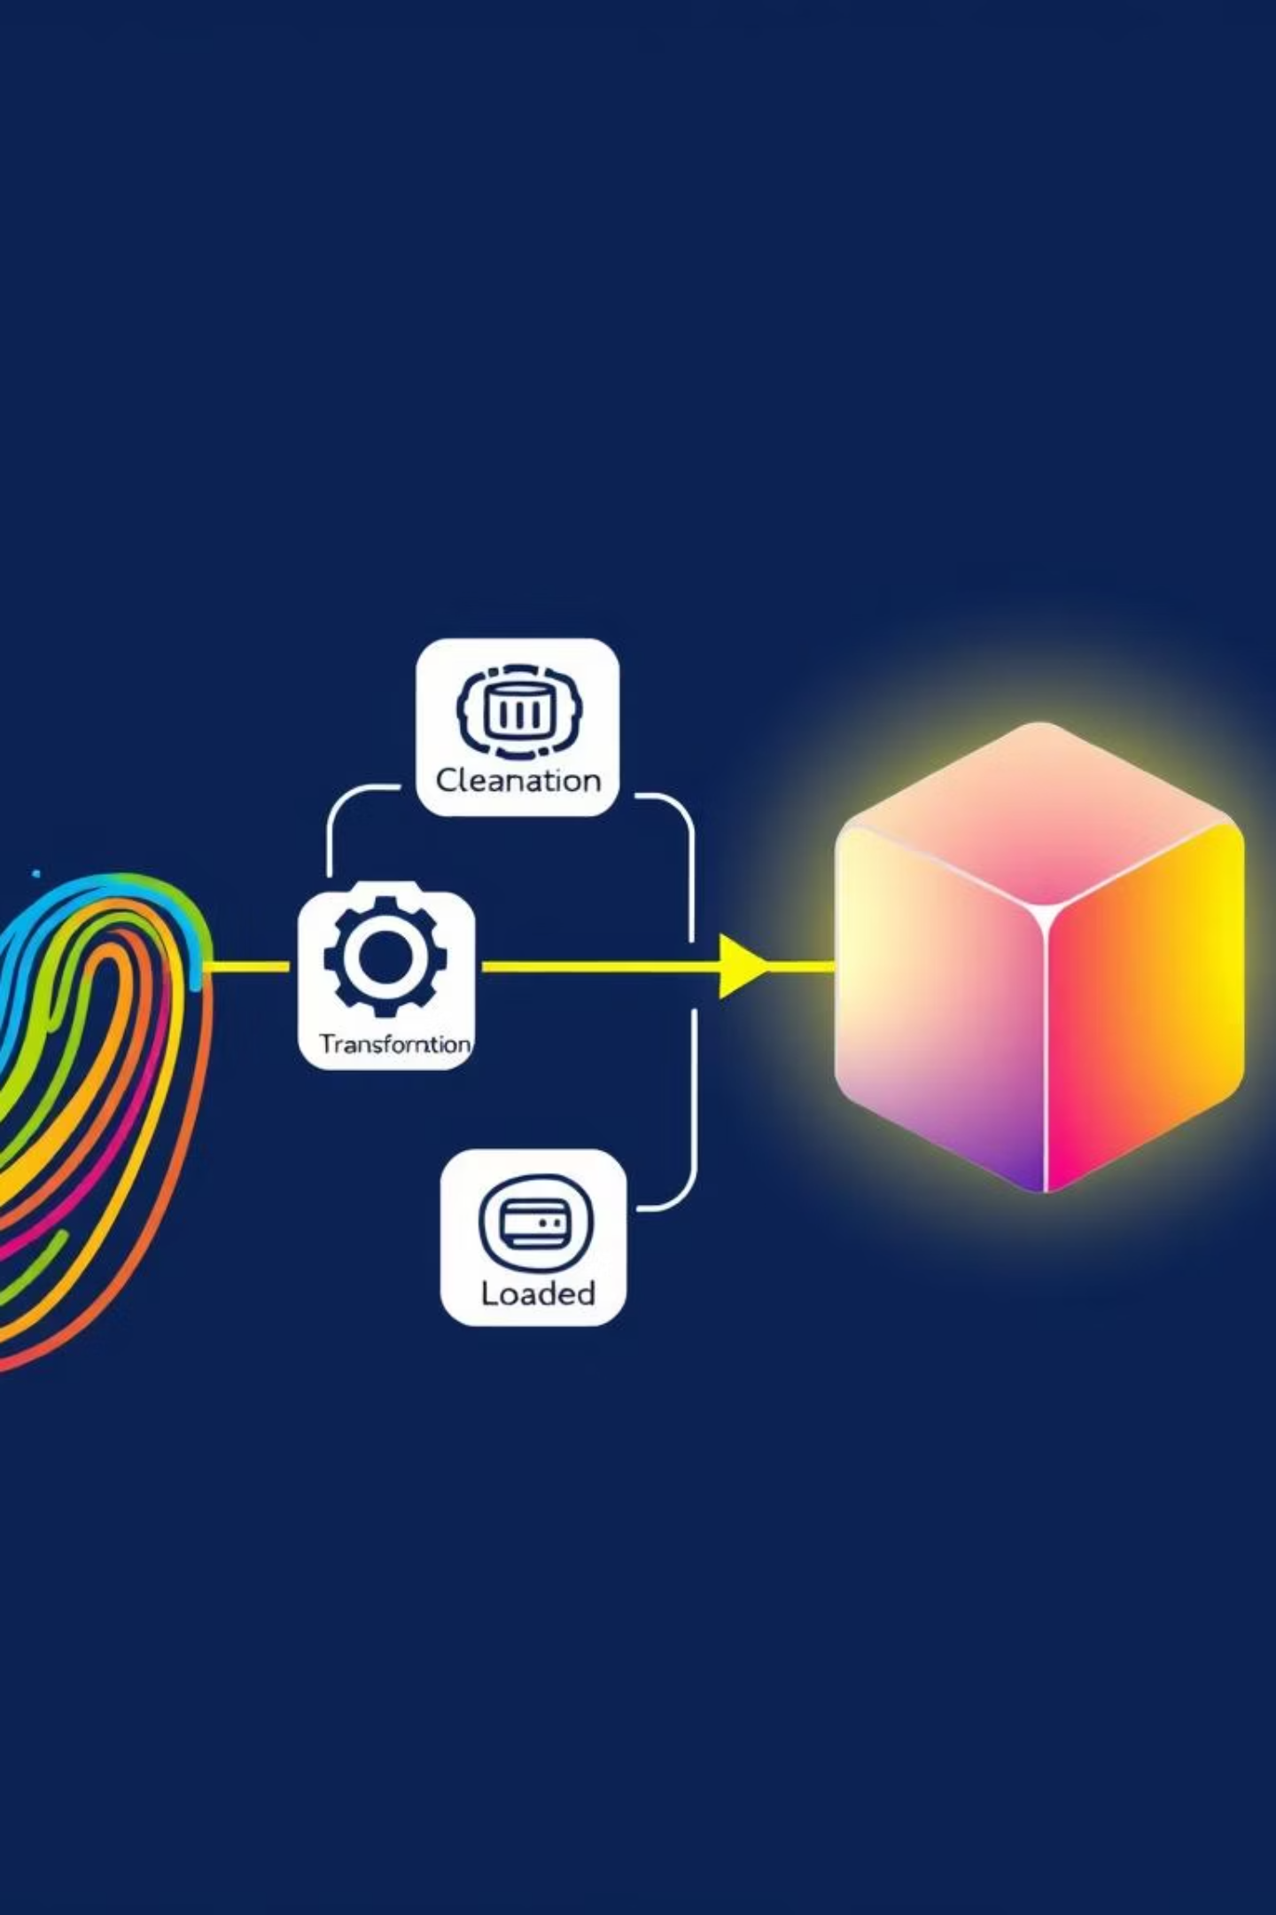




ETL Process – Clean → Transform → Load
The ETL process in Power Query transformed raw data into a robust dataset, ready for dashboard creation.
Data Cleaning
Removed null values and duplicates to ensure data integrity.
Date Table Creation
Generated a dedicated date table for time intelligence functions.
Column Formatting
Renamed and formatted columns for consistency and usability.
Data Loading
Loaded the refined data into the Power BI data model.

Slide 8
Power BI Dashboard – Final Output
The dashboard offers both high-level summaries and detailed views, providing full interactivity and filtering capabilities.
Dashboard Features:
Region-wise filtering for targeted analysis.
KPI cards for quick performance metrics.
Drill-down functionality by product for granular insights.
Dynamic bar and line charts for trend visualization.

Slide 9
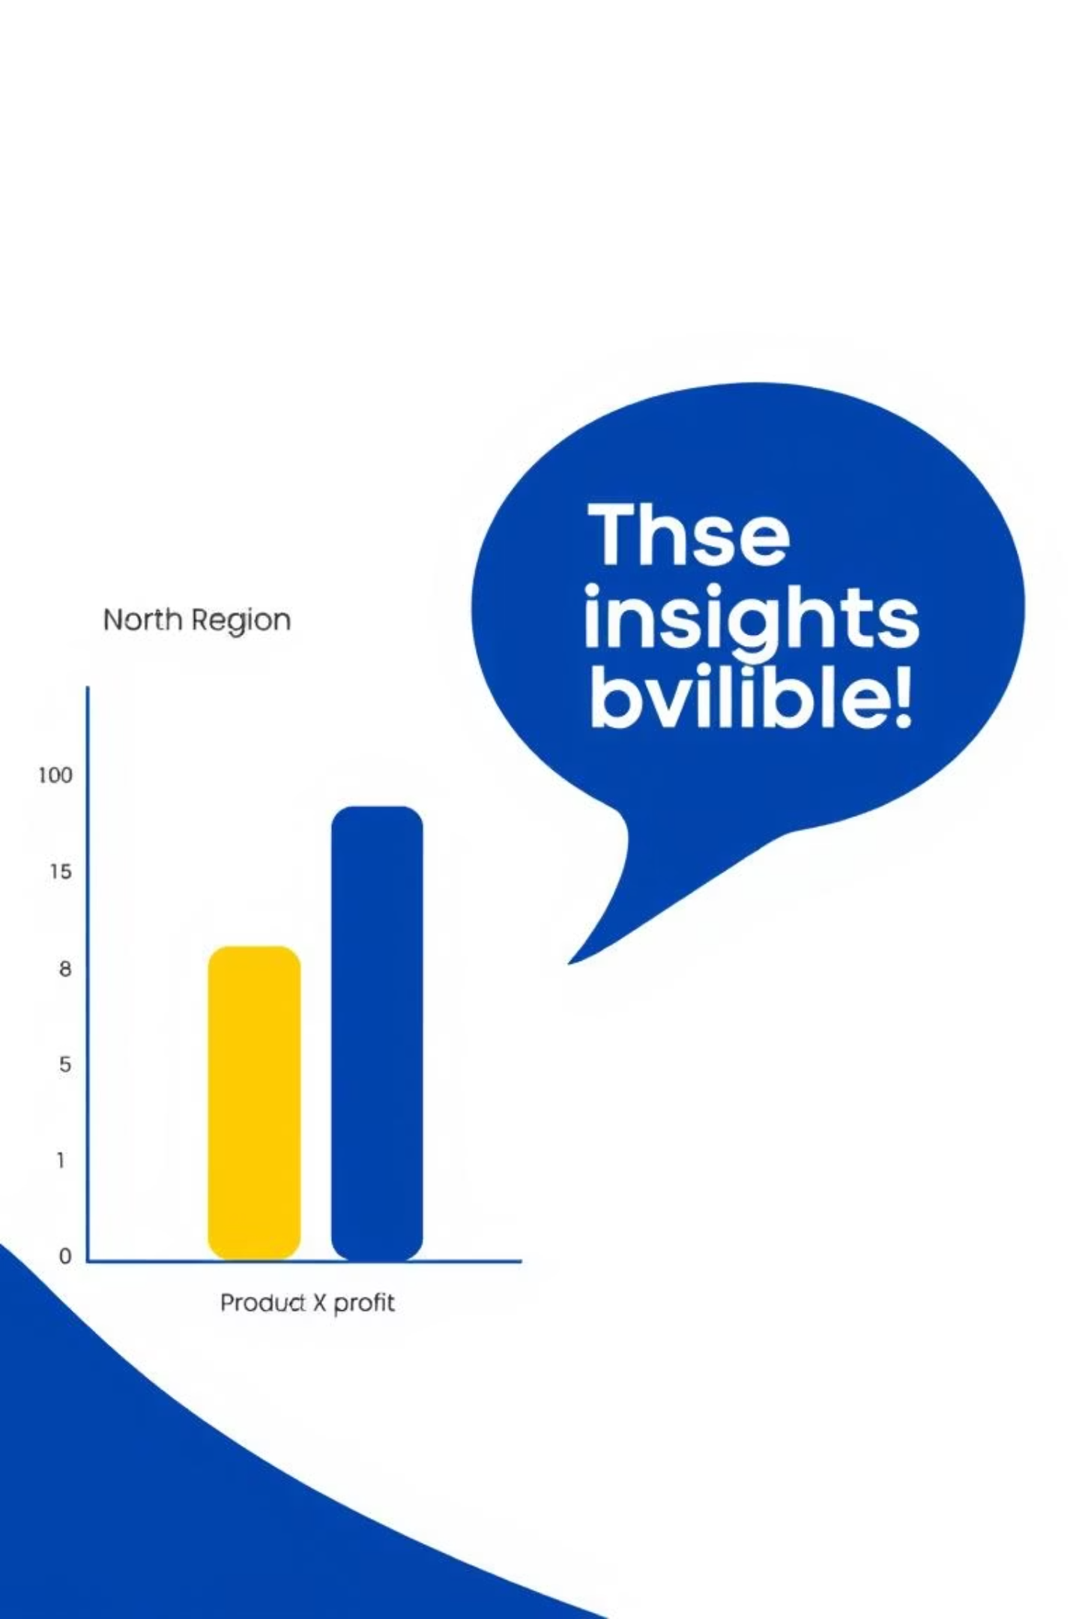
Key Insights + Stakeholder Feedback
North Region Performance
Product X Profitability
Highest revenue generated, but with moderate profit margins.
High sales volume, yet surprisingly low profitability observed.
Positive Usability Feedback
Stakeholders praised the dashboard's ease of use.
“Helps our sales team act faster!” – Bhavin, Sales Director
Our analysis identified top-performing areas and highlighted hidden inefficiencies.

Slide 10




Conclusion & Learnings
Data Storytelling
1
Mastered converting data into compelling narratives.
SQL & DAX Mastery
2
Honed skills in both data query and analysis languages.
Power BI Workflow
3
Gained hands-on experience in the complete Power BI cycle.
This project delivered a professional dashboard from real data, providing actionable business insights.

